Slide 1
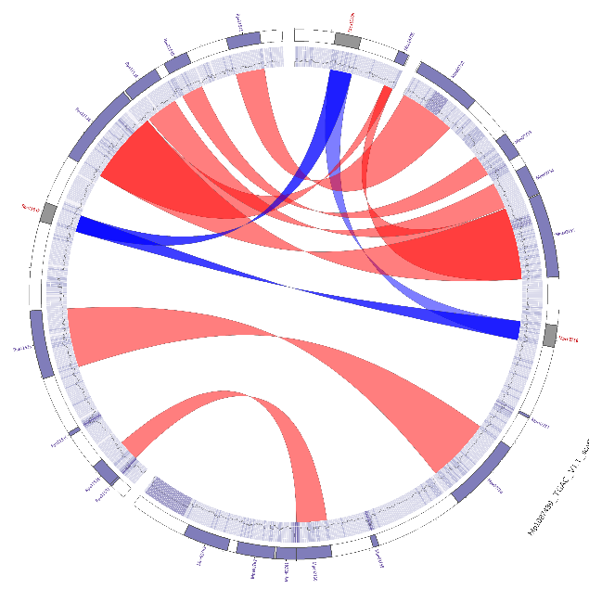
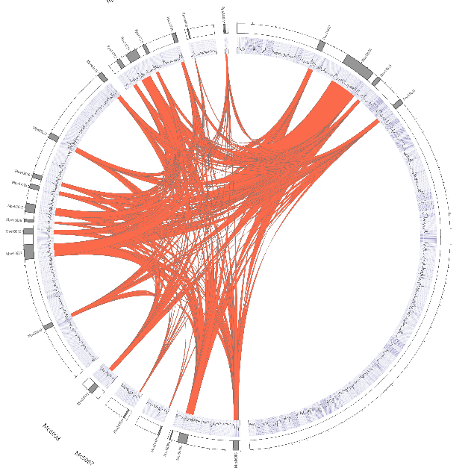
Genome assembly University of St Andrews Bioinformatic Unit (StABU) Peter Thorpe And Carolin Kosiol

Slide 2
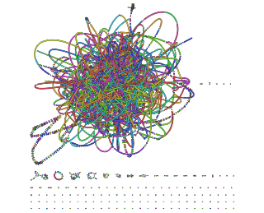
Overview
1: History of sequencing methods and cost
2: Historical methods for assembly
3: Library prep
4: De Bruijn Graphs
5: overview of assembly methods
6: Full assembly procedure
7: Final assembly. What next
8: Misc section

Slide 3
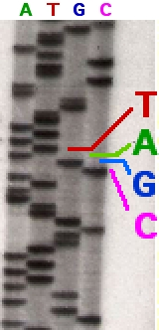
1) History of sequencing
Radio labelled bases were run on gels an manually interpreted for the order of the bases. Very small regions done at a time. Years to complete a gene https://agctsequencing.wordpress.com/2012/08/01/sanger-sequencing-historical-development-of-automated-dna-sequencing
https://en.wikipedia.org/wiki/Sanger_sequencing

Slide 4
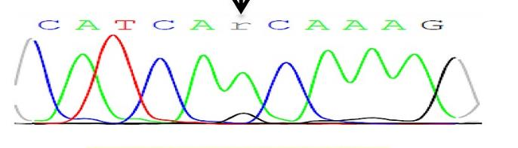
1) History of sequencing
Radio labelled bases were run on gels an manually interpreted for the order of the bases. Very small regions done at a time. Years to complete a gene https://agctsequencing.wordpress.com/2012/08/01/sanger-sequencing-historical-development-of-automated-dna-sequencing
Sanger sequencing (~1990s): A capillary method, highly accurate, fluorescent dyes were recorded and interpreted computationally. (Very high cost, ~1000bp reads, can be “confused” by heterozygosity).
https://plos.figshare.com/articles/figure/_Images_of_Sanger_sequencing_electropherogram_showing_novel_mutations_left_panel_detected_in_the_study_cohort_reverse_direction_and_the_corresponding_wild_type_sequence_right_panel_of_normal_tissue_sections_for_the_same_patient_indicating_the_somatic_orig/1248566/1

Slide 5
1) History of sequencing
Sanger sequencing: It is still used today for cloning, as the cost per sample ~£3. (for the human genome ~$300million, although final cost $2.7 billion):
454/ Solexa/ Ion Torant (~2006): pyrosequencing technology, relatively expensive totally discontinued.
Illumina (2002 – present): (Next Generation Seq technology: NGS). Massive reduction in cost per Giga base. Huge coverage, still used heavily today! Short reads. 2 X 50 – 250bp. (today <$600 to sequence the human genome). (new machine $200?)
Third Generation Sequencing Technology: Nanopore (used heavily during the COVID epidemic), PacBio … Both can produce very long reads, both companies lie ;) about the read quality (indels due to homopolymers). - can detect methylated DNA bases too…

Slide 6
1) History of sequencing
Sanger, Illumina and PacBio use “cameras” to detect fluorescence.
Nanopore detects potential difference (voltage) change as the bases passes through the pore.

Slide 7
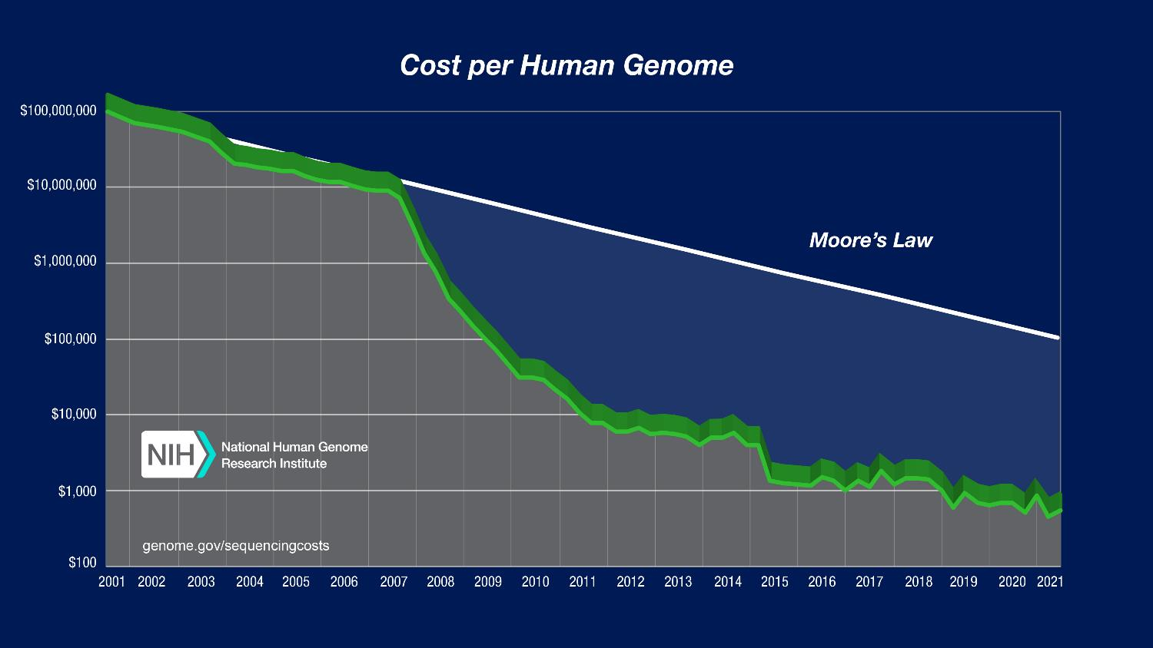
1) History of sequencing
Sanger sequencing: It is still used today for cloning as the cost per sample ~£3.
454/ Solexa/ Ion Torant (~2006): pyrosequencing technology, relatively expensive totally discontinued.
Illumina: (Next Generation Seq technology). Massive reduction in cost per Giga base. Huge coverage, still used heavily today! Short reads. 2 X 50 – 250bp.
Third Generation Sequencing Technology: Nanopore (used heavily during the COVID epidemic), PacBio … Both can produce very long reads, both companies lie ;) about the read quality (indels due to homopolymers).
https://www.genome.gov/about-genomics/fact-sheets/Sequencing-Human-Genome-cost
As you can see from the graph, the cost has far out paced computers (Moore’s law) – oh dear! - this kind of matters … we will come to this

Slide 8
Cost per sequencing method
Nanopore, PacBio and Illumina regularly release upgrade and new chemistries that improve these figure all the time.
 | Sanger | Illumina HiSeq2500 | PacBio | Nanopore
Read Length | ~1000bp | 2 X (50 - 250)bp | 10 - 35 kb | up to 1.6 million
Yield | 80 kb | 500Gb | 10Gb | ~2Gb
Price per Gb | £1 million | $30 | $125 | $750
Update: Illumina Novaseq X plus now output 16TB!!! $2 per gigabyte
$40 has been suggested
Fatima, N., Petri, A., Gyllensten, U., Feuk, L. and Ameur, A., 2020. Evaluation of single-molecule sequencing technologies for structural variant detection in two swedish human genomes. Genes, 11(12), p.1444.
Li, Changsheng & Lin, Feng & An, Dong & Wang, Wenqin & Huang, Ruidong. (2017). Genome Sequencing and Assembly by Long Reads in Plants. Genes. 9. 6. 10.3390/genes9010006. –( some values altered from this to reflect the past few years. )

Slide 9
Overview
1: History of sequencing methods and cost
2: Historical methods for assembly
3: Library prep
4: De Bruijn Graphs
5: overview of assembly methods
6: Full assembly procedure
7: Final assembly. What next
8: Misc section

Slide 10
2) History assembly methods
The reads from Sanger sequencing were subjected to assembly via overlap consensus using programs such as cap3
Great just keep putting them on top of each other (cannot resolve repeat > 1000bp. Coverage is poor due to cost.
https://www.ncbi.nlm.nih.gov/pmc/articles/PMC310812/
A real example using Cap3

Slide 11
2) History of sequencing
Ok, so you have 80 Kb of data that you can “stack” on top of each other and do an over lap consensus assembly. This is ok for Sanger data
…. Buuuuuut Illumina comes along. You now have 500Gb (16TB?)
An estimate ~10 years ago suggested that it would take the fastest computing cluster on earth 100 years to assemble a genome using overlap consensus with Illumina data (using, at the time, those methods).
….. What to do …?????

Slide 12
Overview
1: History of sequencing methods and cost
2: Historical methods for assembly
3: Library prep - reminder
4: De Bruijn Graphs
5: overview of assembly methods
6: Full assembly procedure
7: Final assembly. What next
8: Misc section

Slide 13
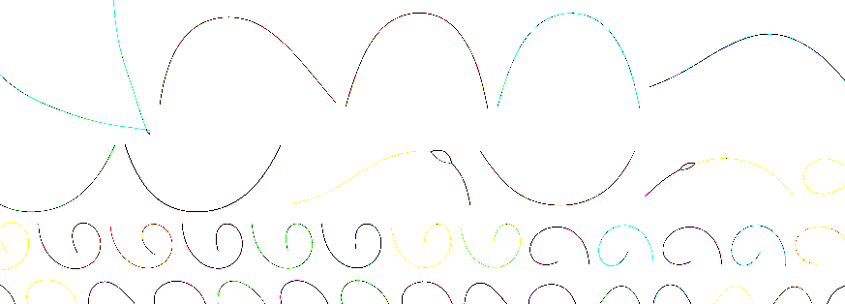
3: Reminder/ introduce the library preparation (lib prep) to you
Starting material: for example, Bacterial genome is circular (with unknown number of separate plasmids).
Lib prep: Smash (shear) this into millions of bits, size selection, and put them in sequencing vectors.
Illumina example below (for TGS, longer reads and do not small the DNA up):
Original genome million of fragments - Illumina complex jigsaw puzzle
The likely result is a fragmented mess ☺
Note error rate 1:1000

Slide 14
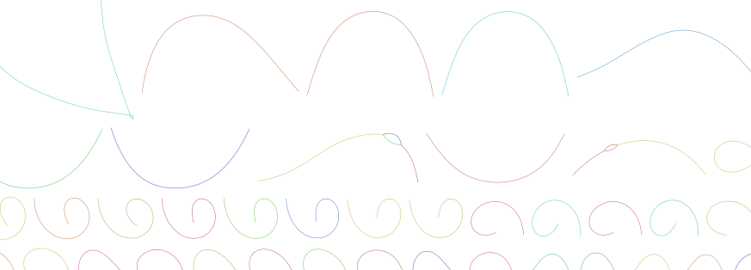
3: Reminder/ introduce the library preparation (lib prep) to you
Put the complex jigsaw puzzle into Contigs. Then the contigs into scaffolds
Original genome million of fragments - Illumina complex jigsaw puzzle
The likely result is a fragmented mess ☺
Note error rate 1:1000

Slide 15
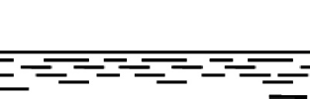
3: Reminder of what we are trying to do: (Hierarchical structure)
reads
contigs
scaffolds

Slide 16
Overview
1: History of sequencing methods and cost
2: Historical methods for assembly
3: Library prep
4: De Bruijn Graphs
5: overview of assembly methods
6: Full assembly procedure
7: Final assembly. What next
8: Misc section

Slide 17
4) WHAT TO DO: De Bruijn Graphs
De Bruijn graphs were developed as a way to overcome the computational limitations.
An overview: Compeau, P.E., Pevzner, P.A. and Tesler, G., 2011. How to apply de Bruijn graphs to genome assembly. Nature biotechnology, 29(11), pp.987-991.
De Bruijn graphs: Nodes are the kmers-1 (k-1) - mers (see later), Edges are the kmer.
{AGC, ATC, ATT,CAG, CAT, GCA, TCA, TTC}
TT
TC
AT
CA
GC
AG
* Start here: kmer = 3

Slide 18
4) De Bruijn Graphs (example kmer=3)
{AGC, ATTCA, CATT, GCAG, TCA, TTC}
Nodes are (k-1)- mers
Edges are k-mers
Reads are walks
Find Superwalk (one that includes all walks)
TT
TC
AT
CA
GC
AG

Slide 19
4) De Bruijn Graphs
{AGC, ATTCA, CATT, GCAG, TCA, TTC}
Nodes are (k-1)- mers
Edges are k-mers
Reads are walks
Find Superwalk (one that includes all walks). Paths are weighted by coverage/ evidence.
TT
TC
AT
CA
GC
AG

Slide 20
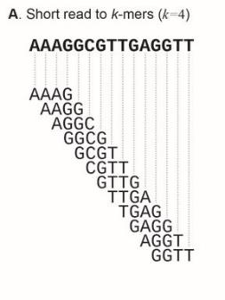
4) De Bruijn Graphs
In this example, the read is split into 4-mers. (k-mer)
Errors, heterozygosity, contamination, repeats (semi-repeats) can then cause this to be difficult to “untangle” which leads to bubbles (real examples to come). Untangle: pick the longest path through the graph.
Alu repeat is 300bp and is present 1,000,000 times in the human genome
Repeats are often collapsed and they cannot be resolved.
Sohn, J.I. and Nam, J.W., 2018. The present and future of de novo whole-genome assembly. Briefings in bioinformatics, 19(1), pp.23-40.

Slide 21
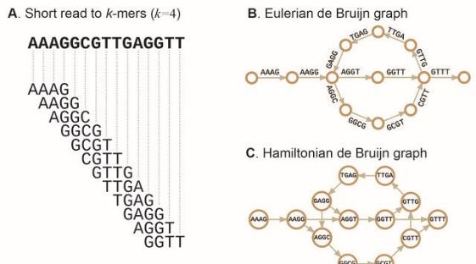
4) De Bruijn Graphs, kmers and bubbles
Bubbles are formed when there is a conflict in the sequence. Can become impossible, thus a fragmented assembly.
This part could have 100X coverage
Sohn, J.I. and Nam, J.W., 2018. The present and future of de novo whole-genome assembly. Briefings in bioinformatics, 19(1), pp.23-40.

Slide 22
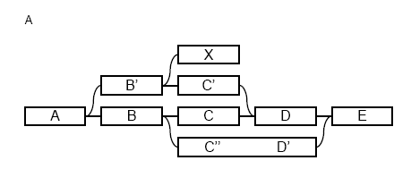
4) De Bruijn Graphs, kmers and bubbles
Bubbles are formed when there is a conflict in the sequence. Can become impossible, thus a fragmented assembly.
Second step: remove bubbles using Tour Bus or Bubblegun
(Fawaz Dabbaghie, Jana Ebler, Tobias Marschall, BubbleGun: enumerating bubbles and superbubbles in genome graphs, Bioinformatics, Volume 38, Issue 17, 1 September 2022, Pages 4217–4219,)
Redundant paths start and end at the same nodes

Slide 23
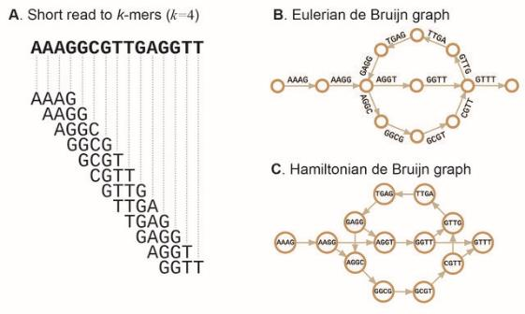
4) Kmers and De Bruijn graph
Real example of a graph (more of a hair ball!!)
https://holtlab.net/2015/02/25/bandage-view-and-navigate-assembly-graphs/
Sohn, J.I. and Nam, J.W., 2018. The present and future of de novo whole-genome assembly. Briefings in bioinformatics, 19(1), pp.23-40.

Slide 24
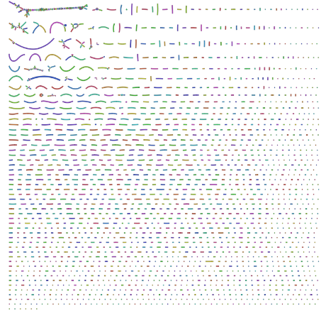
4) Kmers and De Bruijn graph – kmer value depends on your data and organism
A kmer too small results in too many nodes and edges are there are not enough unique kmers for the assembler.
In contrast a kmer too high can lead to not enough coverage and too many unique kmer to join the sequences together leading to a very fragmented assembly
Pick the best: depends on coverage and genome size, read length, quality. Kmergenie!
https://github.com/rrwick/Bandage/wiki/Effect-of-kmer-size

Slide 25
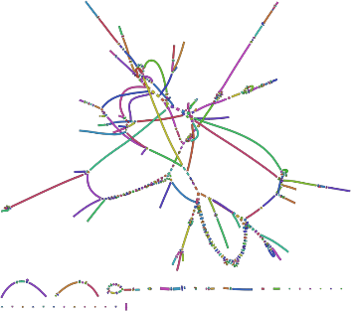
4) Kmers and De Bruijn graph
kmer too small (k=19)
kmer too big (k=127)
~optimal (k=53)
(ish, for this data)
https://github.com/rrwick/Bandage/wiki/Effect-of-kmer-size <- essential reading

Slide 26
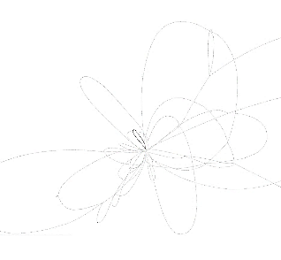
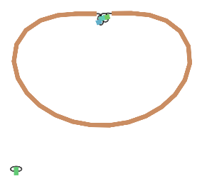
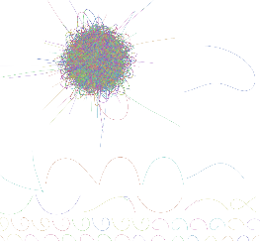
4) Draw your own graphs - when it come to the actual work
http://rrwick.github.io/Bandage/
How: https://github.com/rrwick/Bandage/wiki/Getting-started
Use the graphs in the graphs folder (our dataset!)
K=19 K=53 Unicycler
https://github.com/rrwick/Unicycler <- essential reading

Slide 27
Overview
1: History of sequencing methods and cost
2: Historical methods for assembly
3: Library prep
4: De Bruijn Graphs
5: overview of assembly methods
6: Full assembly procedure
7: Final assembly. What next
8: Misc section

Slide 28
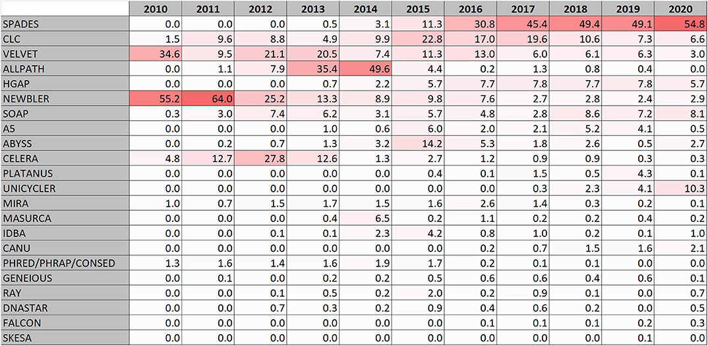
5) Overview of assembly methods
Heat map of the most popular assembly programs for bacteria
Segerman et al., 2020. The Most Frequently Used Sequencing Technologies and Assembly Methods in Different Time Segments of the Bacterial Surveillance and RefSeq Genome Databases, DOI=10.3389/fcimb.2020.527102 . Frontiers in Cellular and Infection Microbiology

Slide 29
5) De Bruijn graphs/ greedy algorithm or both
Most assemblers these days employ a mixture of methods (for example Spades).
Graph based approaches. e.g. De Bruijn.
“greedy algorithm”: Cluster reads based on pairwise distance, then clusters on overlap, assembles based on over lap .. Repeat to form contigs. (https://www.biorxiv.org/content/10.1101/2021.02.02.429443v1.full)

Slide 30
5) Overview of assembly methods
Assembly is difficult due to:
Repeats. Some repeats can be 100,000bp long!!!
Size: Bacteria ~4Mbp. Compare to Japanese flower Paris japonica 149Gbp
Heterozygosity: If you have an inbread diploid population then the “bubbles” will be relatively more easily resolved compared to a highly outbreeding population.
Contamination … see later
Ploidy. Think of the octopoid strawberry genome ☺ ☺ ☺ (Edger, P.P., Poorten, T.J., VanBuren, R., Hardigan, M.A., Colle, M., McKain, M.R., Smith, R.D., Teresi, S.J., Nelson, A.D., Wai, C.M. and Alger, E.I., 2019. Origin and evolution of the octoploid strawberry genome. Nature genetics, 51(3), pp.541-547.)
Third generation data (TGS): This has indels and the reads are error prone (albeit they say this is changing). Therefore the TGS needs to be polished with Illumina data. For medium sized genomes and up - you need 1.5+Tb of RAM!!

Slide 31
5 ) Repeats
Bacterial genomes: 5%
Mammals: up to 80 %
Repeat types:
Low-Complexity DNA (e.g. ATATATATACATA…)
Microsatellite repeats (a₁…a_{k})^{N} where k ~ 3-6
(e.g. CAGCAGTAGCAGCACCAG)
Transposons
SINE (Short Interspersed Nuclear Elements)
e.g., ALU: ~300-long, 10⁶ copies
LINE (Long Interspersed Nuclear Elements)
~4000-long, 200,000 copies
LTR retroposons (Long Terminal Repeats (~700 bp) at each end)
cousins of HIV
Gene Families genes duplicate & then diverge (paralogs)
Recent duplications ~100,000-long, very similar copies
Whole genome duplications ~100,000-long, very similar copies

Slide 32
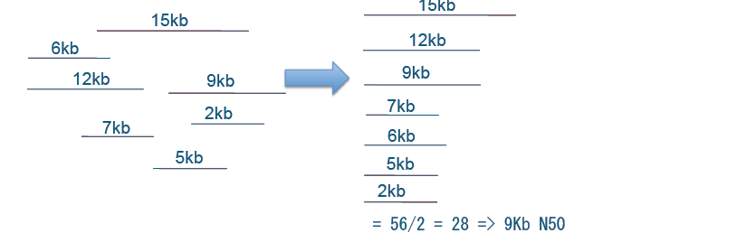
5) N50 (longer is better). Assembly contiguity metric
Size of contig such that 50% of total bases are in contigs of this length or more
Sum of lengths: 56 kb
contigs
how many
total bases
N50
scaffolds
how many
total bases
N50
how many gaps
total gap bases
Thomas Keane and Jan Aerts, Wellcome Trust Sanger

Slide 33
5) Contamination
It is inevitable you will get some contamination in your DNA prep, lib prep, if your animal was eating a plant … what ever ..
Once the contigs have been assembled, these can be BLAST searched against GenBank nt database (we will do this bit).
The results will be interrogated by summing the bit scores per phylum (taxonomic classification)
And thus beasties not in your phylum are contamination. (Blobtools).

Slide 34
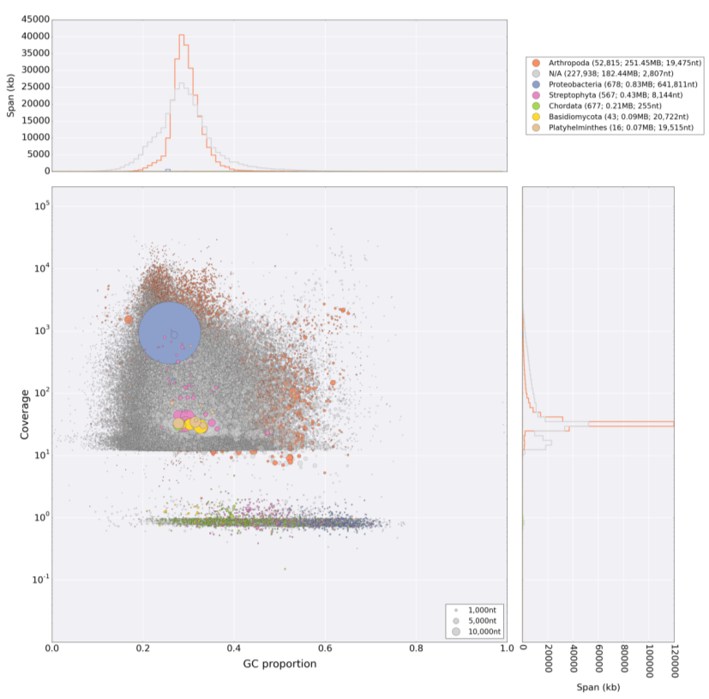
Contamination example
This beast is an aphid Arthropoda
THIS IS not CLEAN
Low coverage mess: sequencing errors

Slide 35
Contamination removed: This beast is a nematode … go on ask me about the elephant in the room!!!! (orange)

Slide 36
Overview
1: History of sequencing methods and cost
2: Historical methods for assembly
3: Library prep
4: De Bruijn Graphs
5: overview of assembly methods
6: Full assembly procedure
7: Final assembly. What next
8: Misc section

Slide 37
6) Procedure of how to “assemble” the contigs
Contigs: are the initial assembled fragments from the raw reads, contigs should not contain NNs (unknown bases).
Many options: depends on your data and organism
FastQc
Trimmomatic
Quality control
Quality trim
Quality control
Assemble (different kmers, different tools)
Check assembly metrics here between various tools/ parameters
I can talk for hours about this bit .. But I wont ;)

Slide 38
6) Procedure of how to “assemble” the contigs
Contigs: are the initial assembled fragments from the raw reads, contigs should not contain NNs (unknow bases).
Many options: depends on your data and organism
FastQc
Trimmomatic
Blobtools
Quality control
Quality trim
Quality control
Assemble (different kmers, different tools)
*Contamination clean *
Pilon, Arrow, Nanopolish
Check assembly metric here between various tools
FINAL CONTIGS
Polish
NOW WHAT??

Slide 39
6) We have contigs - what next?
Scaffold: “place” the contigs together separated by a known length of unknown bases, called NNNNNNs. Therefore, scaffolds are an ordered collection of 2 or more contigs.
For eukaryotic organisms the next step would be to scaffold, either with mate pair libraries (SSPACE), HiC (current best), long read data …
Then gap fill: TGSgapfiller….
Various tools:
SSPACE, HiC
TGSgapfiller,
Gapless
Final contigs
Scaffold
GapFill

Slide 40
6) We have contigs - what next? - Scaffold
….
Polish the final assembly: Pilon
Repeat model/ Mask (RepeatModeller/ Masker)
Predict genes (must choose a eukaryotic or prokaryotic specific tool here!!)
This is long process which is different for every beastie, every data set and a new tools comes out every week.
Various tools:
SSPACE, HiC
TGSgapfiller
Blobtools
Final contigs
Scaffold
GapFill
Final polish
Contamination check
Predict genes
Repeat mask
FINAL scaffolds

Slide 41
Overview
1: History of sequencing methods and cost
2: Historical methods for assembly
3: Library prep
4: De Bruijn Graphs
5: overview of assembly methods
6: Full assembly procedure
7: Final assembly. What next
8: Misc section

Slide 42
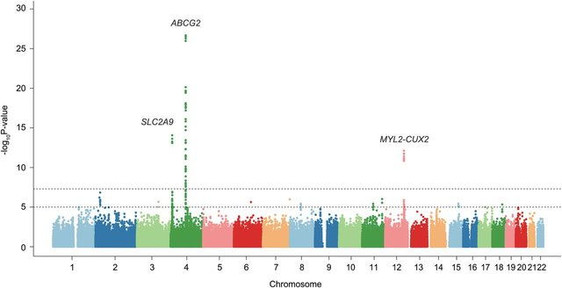
7) Final genome assembly – what next?
RNAseq: Identify gene differentially expressed between conditions.
GWAS: Find disease causing variants between phonotypic and control populations.
Population genomics: sooo much here!!
Genomic and population variants.
Selective breeding for traits.
Vaccine targets.
Cancer targets.
Gene therapy.
Synthetic biology
.. Anything in biology
.. and medicine.
Precision medicine
Metagenomics
Microbiomes …
DOI 10.1136/annrheumdis-2014-206191

Slide 43
Overview
1: History of sequencing methods and cost
2: Historical methods for assembly
3: Library prep
4: De Bruijn Graphs
5: overview of assembly methods
6: Full assembly procedure
7: Final assembly. What next
8: Misc section

Slide 44
8) Fastq format (Illumina output)
The input to most of the following steps, are the fastq (or compressed fastq.gz) files.
@ERR861370.21 M00596:40:000000000-A712Y:1:1101:11010:1548/1 (unique read name)
GTCCAGAACTGTCTTCTGTAAATCTTTCTTGTACCTCCTGCAGTAT (sequence)
+ (+)
-B@C<8<@CF9FEFFFGAF9<<EEFGGEFF9E9CCC,CF<,,C,,< (ascii quality score encoding)
Each base is “quality scored” based on a probability score of it being correct.
Q15: p = 0.03
Q30: p = 0.001
Read more: https://en.wikipedia.org/wiki/FASTQ_format

Slide 45
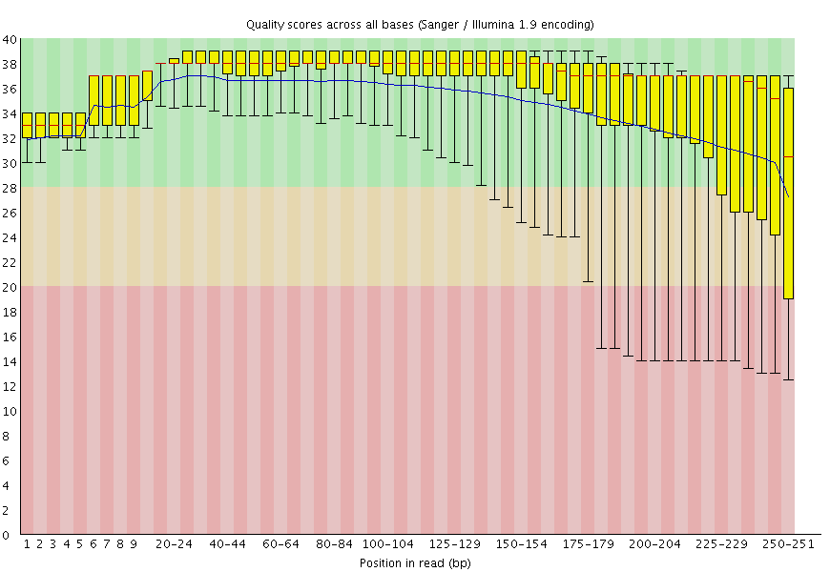
8) Fastqc output - Quality check
https://en.wikipedia.org/wiki/FASTQ_format
Q15 line: p = 0.03 of the base being correctly called. When you have 1 billion bases, there are still many by chance that will be incorrect.

Slide 46
8) Assembly: output format (fasta)
The main file you will work with is called assembly.fa or some programs will output a XYZ.fasta . This is like so:
>NAME_OF_CONTIG_1
ATTAGGGGGGGCGGA … etc seq
>NAME_OF_CONTIG_2
ATTACCCCCCCCCCCGGA … etc seq
>NAME_OF_CONTIG_3
ATTTTTTTTTTTTTGA … etc seq
Each > is a new contig. There can be many many thousands of these.
A contig is an assembled part of the genome containing zero NNNs (N is an unknown base, which cannot be resolved).
Scaffolds are collections of 2 or more contigs separated by NNNs.

Slide 47
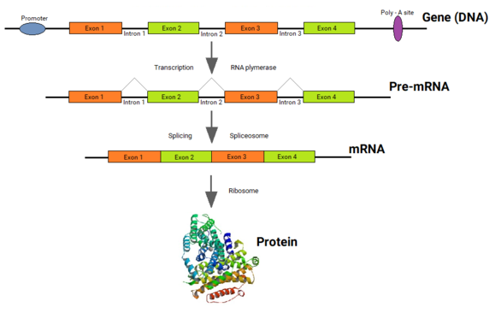
8) Eukaryotic Gene Structure
Eukaryotes have complex gene structure which can span MANY thousands of nucleotides
DNA
https://en.wikipedia.org/wiki/Split_gene_theory

Slide 48
8) Eukaryotic Gene Structure
Eukaryotes have complex gene structure which can span MANY thousands of nucleotides
start
end
Many different splicing patterns of the exons happen. E.g. 1,3,4 or 1,4 or 1,2,4. … 1,2,3,4
Or even 2,3,4 if an alternative start is present
https://en.wikipedia.org/wiki/Split_gene_theory

Slide 49
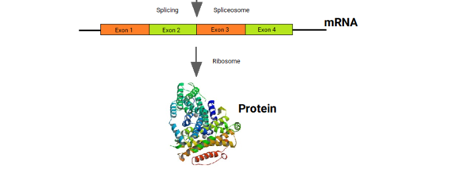
8) Eukaryotic Gene Structure
The final, spliced product which only contains the coding sequence is sent for sequencing. This is directly relevant to the protein sequence.
Thus, a MUCH smaller amount of data to deal with
start
end
https://en.wikipedia.org/wiki/Split_gene_theory

Slide 50
Reading (just get an overview… wide range here)
Bachtiar, M., Ooi, B.N.S., Wang, J., Jin, Y., Tan, T.W., Chong, S.S. and Lee, C.G., 2019. Towards precision medicine: interrogating the human genome to identify drug pathways associated with potentially functional, population-differentiated polymorphisms. The pharmacogenomics journal, 19(6), pp.516-527.
Quigley, K.M., Bay, L.K. and van Oppen, M.J., 2020. Genome‐wide SNP analysis reveals an increase in adaptive genetic variation through selective breeding of coral. Molecular Ecology, 29(12), pp.2176-2188.
The genome and lifestage-specific transcriptomes of a plant-parasitic nematode and its host reveal susceptibility genes involved in trans-kingdom synthesis of vitamin B5 https://www.biorxiv.org/content/10.1101/2021.10.01.462558v1
Li, L., Liu, X., Wei, K., Lu, Y. and Jiang, W., 2019. Synthetic biology approaches for chromosomal integration of genes and pathways in industrial microbial systems. Biotechnology advances, 37(5), pp.730-745.
Zhang, X., Rayner, J.G., Blaxter, M. and Bailey, N.W., 2021. Rapid parallel adaptation despite gene flow in silent crickets. Nature Communications, 12(1), pp.1-15.
Eising, E., Mirza-Schreiber, N., de Zeeuw, E.L., Wang, C.A., Truong, D.T., Allegrini, A.G., Shapland, C.Y., Zhu, G., Wigg, K.G., Gerritse, M.L. and Molz, B., 2022. Genome-wide analyses of individual differences in quantitatively assessed reading-and language-related skills in up to 34,000 people. Proceedings of the National Academy of Sciences, 119(35), p.e2202764119.
Hill, C.B., Angessa, T.T., Zhang, X.Q., Chen, K., Zhou, G., Tan, C., Wang, P., Westcott, S. and Li, C., 2021. A global barley panel revealing genomic signatures of breeding in modern Australian cultivars. The Plant Journal, 106(2), pp.419-434.
Nakagawa, H. and Fujita, M., 2018. Whole genome sequencing analysis for cancer genomics and precision medicine. Cancer science, 109(3), pp.513-522.
Chiu, C.Y. and Miller, S.A., 2019. Clinical metagenomics. Nature Reviews Genetics, 20(6), pp.341-355.
Wensel, C.R., Pluznick, J.L., Salzberg, S.L. and Sears, C.L., 2022. Next-generation sequencing: insights to advance clinical investigations of the microbiome. Journal of Clinical Investigation, 132(7), p.e154944.

Slide 51
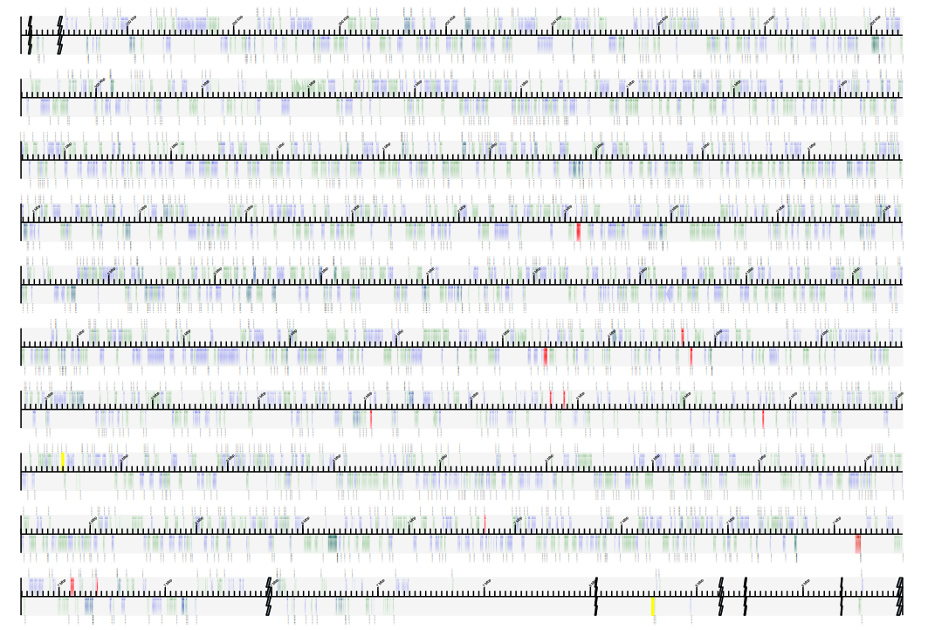
That’s all folks
Enjoy ☺

Slide 52
Quiz
Construct a de Bruijn graph for the following 4 reads using 3-mers.
–AGTTCA
–ATCAGT
–GTACAG
–CAGTTT
Simplify linear paths to single nodes
Identify tips and bulges

Slide 53
3-mers
AGTTCA
AGT
GTT
TTC
TCA
ATCAGT
ATC
TCA
CAG
AGT
GTACAG
GTA
TCA
ACA
CAG
CAGTTT
CAG
AGT
GTT
TTT

Slide 54
De Brujin Graph
AGTTCA
ATCAGT
GTACAG
CAGTTT
AGT
CAG
GTT
ACA
TTT
TAC
TTC
GTA
TCA
ATC

Slide 55
De Brujin Graph
Euler path: longest walk visiting each edge once
AGT
CAG
GTT
ACA
TTT
TAC
TTC
GTA
TCA
ATC

Slide 56
Another example

Slide 57
(Zerbino &Birney,2008)

Slide 58
